Slide 1
Casebook.org
Universal design key Principles
A Presentation by Clayton L. White

Slide 2
What is Universal design (UD)?
Universal design, noun. the design of environments, buildings, or products so that they can be used by people of all ages, sizes, and abilities
Cambridge Dictionary (https://dictionary.cambridge.org/us/dictionary/english/universal-design)

Slide 3
The Seven Principles of UD
Equitable Use
Flexibility in Use
Simple and Intuitive Use
Perceptible Information
Tolerance for Error
Low Physical Effort
Size and Space for Approach and Use

Slide 4
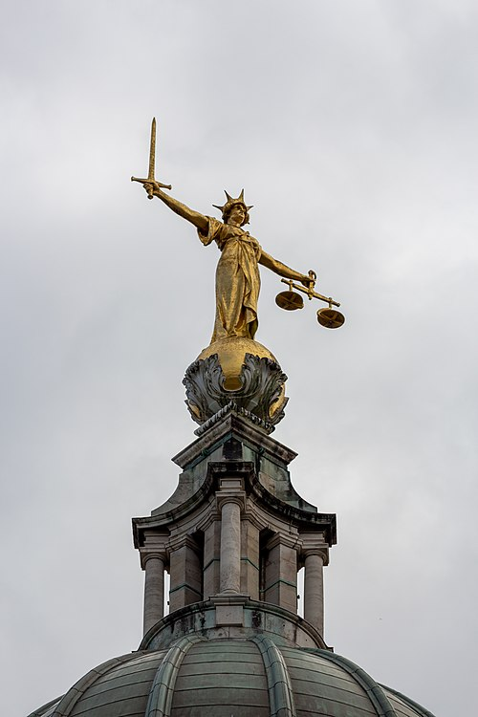
Focus 1: Equitable use
The design is useful to people
with diverse abilities.
Centre for Excellence in Universal Design
                (Image from Wikipedia.org)

Slide 5
Equitable use action items
Color contrast to meet WCAG AA and AAA guidelines
Alt text for all images
Opt for more horizontal layout

Slide 6
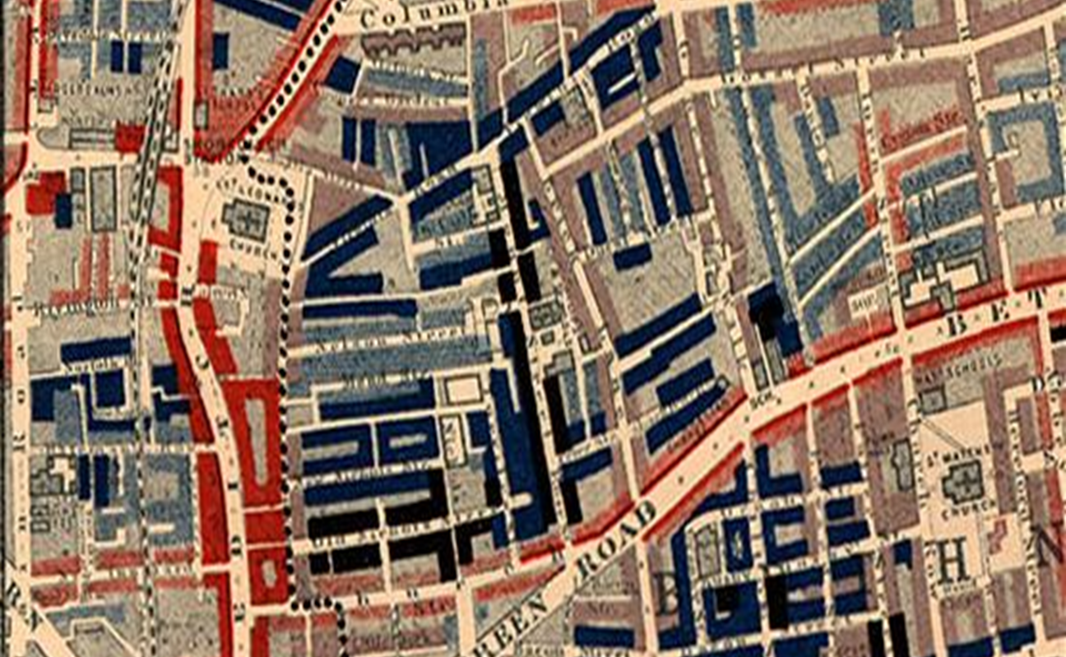
FOCUs 2: Simple and Intuitive Use
(Image from Wikipedia.org)
Use of the design is easy to understand for all users.
Centre for Excellence in Universal Design

Slide 7
Simple/Intuitive Use Action ITEMS
Overhaul/repair bookstore
Improve navigation
Incorporate all subdomains

Slide 8
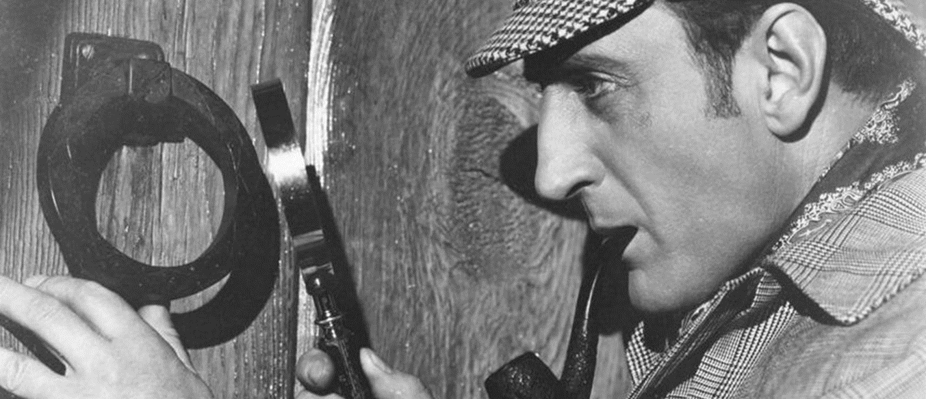
Focus 3: Perceptible Information
Design communicates info to user, regardless of user's abilities.
Centre for Excellence in Universal Design
((Image from BasilRathbone.net)

Slide 9
Perceptible information Action ITEMS
Enlarge Text, Images, and Icons
Font 12 pt. or above
Improve/increase Graphic Design
Icons and images should stand out

Slide 10
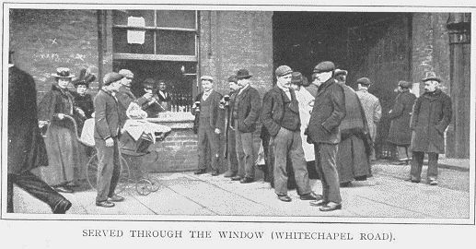
THE end
Universal Design makes life better for all!
(Image from https://www.victorianlondon.org/entertainment/publichouses.htm)

Slide 11
Works Cited
“The 7 Principles.” Centre for Excellence in Universal Design. National Disability Authority, 2025. https://universaldesign.ie/about-universal-design/the-7-principles
“Universal Design, noun.” Cambridge Dictionary, Cambridge University Press & Assessment, 2025. https://dictionary.cambridge.org/us/dictionary/english/universal-design
The wub. “Justice statue on top of the Central Criminal Court, London” Wikipedia, September 10, 2022. https://en.wikipedia.org/wiki/Old_Bailey
Booth, Charles. “Poverty Map of Old Nichol.” https://en.wikipedia.org/wiki/19th-century_London
“Basil Rathbone as Sherlock Holmes.” https://www.basilrathbone.net/films/shadventures/shadv903.jpg
“Served Through the Window (Whitechapel Road).” https://www.victorianlondon.org/entertainment/publichouses.htm

